Slide 1
MCA Final Year Project (Review III) Rebil
Submitted to the Presidency University, Bengaluru in partial fulfilment for the award of the degree of Master of Computer Applications(MCA)
Project Number : MCA_PR216
Under the supervision of
Mr. Sakthi S Asst.Prof-SCSE Presidency University
Name | Roll Number
DEEPAK KUMAR SINGH D | 20232MCA0198

Slide 2
Content
Abstract
Problem Statement
Literature Survey
Tools and Technologies to be used
Modules
Screenshots
References
Github Link

Slide 3
Abstract
Web-Based HR Platform: Built with HTML, CSS, Bootstrap and PHP to streamline HR and admin tasks.
Recruitment Management: Includes an Applicant Tracking System (ATS) for handling applications, interviews and offers.
Document Handling: Allows secure upload, organized storage and quick search of HR documents.
Compliance Tracking: Ensures hiring processes follow company policies and industry standards.
Future Plans: Will add AI-based analytics for better candidate insights and cloud storage for improved security and scalability.

Slide 4
Problem Statement
Many HR departments struggle with managing recruitment, documents and compliance due to the lack of a unified system.
Tracking candidates manually through the hiring process leads to inefficiencies and disorganization.
Storing and retrieving HR documents can be slow and insecure without a proper digital solution.
Ensuring that hiring practices follow company policies and legal standards is challenging without compliance tracking tools.
Current systems often lack scalability, security and advanced features like AI-driven analytics for better decision making.

Slide 5
Literature Review
SL NO | Title of the Paper | Year | Methodology Used | Challenges Faced | Advantages | Disadvantages
1 | AI-Driven HR Management Systems for Efficient Recruitment | 2020 | Machine Learning Algorithms for Resume Screening and Candidate Matching | Data Privacy Concerns | Faster and Accurate Candidate Selection | Bias in AI Models
2 | Integrating HR Software with Social Media Platforms for Talent Acquisition | 2020 | Social Media Data Mining for Candidate Profiling | Data Authenticity and Privacy Issues | Improved Talent Sourcing | Difficulty in Filtering Unqualified Candidates
3 | Cloud-Based HR Solutions for Enhanced Workforce Management | 2019 | Cloud Infrastructure with SaaS Integration | Integration with Legacy Systems | Easy Access and Cost-Effective Solution | Potential Security Risks

Slide 6
Literature Review
SL NO | Title of the Paper | Year | Methodology Used | Challenges Faced | Advantages | Disadvantages
4 | Blockchain Technology in Background Verification Systems | 2021 | Blockchain Ledger for Immutable BGV Records | High Implementation Cost | Enhanced Security and Tamper-Proof Records | Requires Advanced Technical Knowledge
5 | Enhancing Employee Engagement Using Gamification Techniques | 2022 | Gamified Platforms with Reward Mechanisms | Employee Fatigue with Over-Gamification | Improved Motivation and Productivity | Requires Continuous Content Updates
6 | Cloud-Based HR Solutions for Enhanced Workforce Management | 2021 | Real-Time Vendor Collaboration Portals | Vendor Data Management | Faster Closing of Positions | Increased Risk of Miscommunication

Slide 7
Module Design
User Authentication & Login
HR Community

Slide 8
Module Design
User Authentication & Login:
HR Login (Individual & Company)
BGV Company Login
Recruitment Login
Vendor Empanelment
Recruitment Management and HR Community:
Applicant Tracking System (ATS)
Recruitment Analytics & Reporting
Bench Candidate Availability Sharing
HR & Vendor Collaboration
Subscription-based Data Access

Slide 9
Tools And Technologies To Be Used
HARDWARE REQUIREMENTS:
Processor: AMD Ryzen 5 / Intel i5 or higher Hard Disk : 512 GB..
Hard Disk: Minimum 512 GB storage
Monitor: 15” LED display
Input Devices: Keyboard, Mouse
RAM: Minimum 4 GB (8 GB recommended for better performance)

Slide 10
Tools And Technologies To Be Used
SOFTWARE REQUIREMENTS:
Frontend: HTML, CSS, Bootstrap, JavaScript and jQuery
Backend: PHP and MySQL
Other Technologies:
Session management and authentication for secure login
Cloud storage integration (Future enhancement)
Encryption-based document handling (For secure BGV processing)

Slide 11
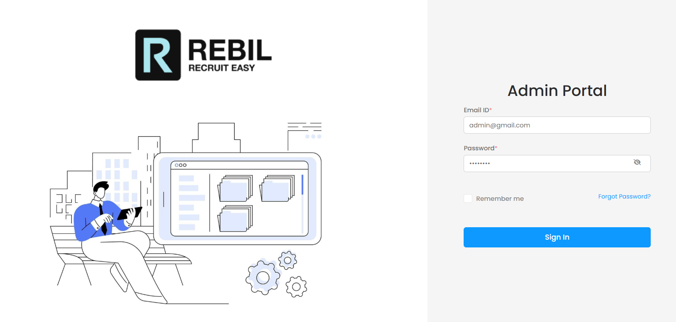
Screenshots
Admin Login Portal

Slide 12
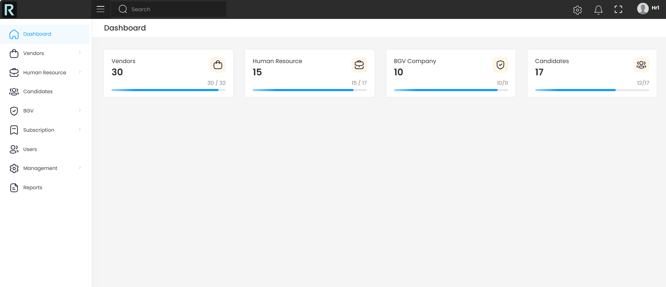
Admin Dashboard

Slide 13
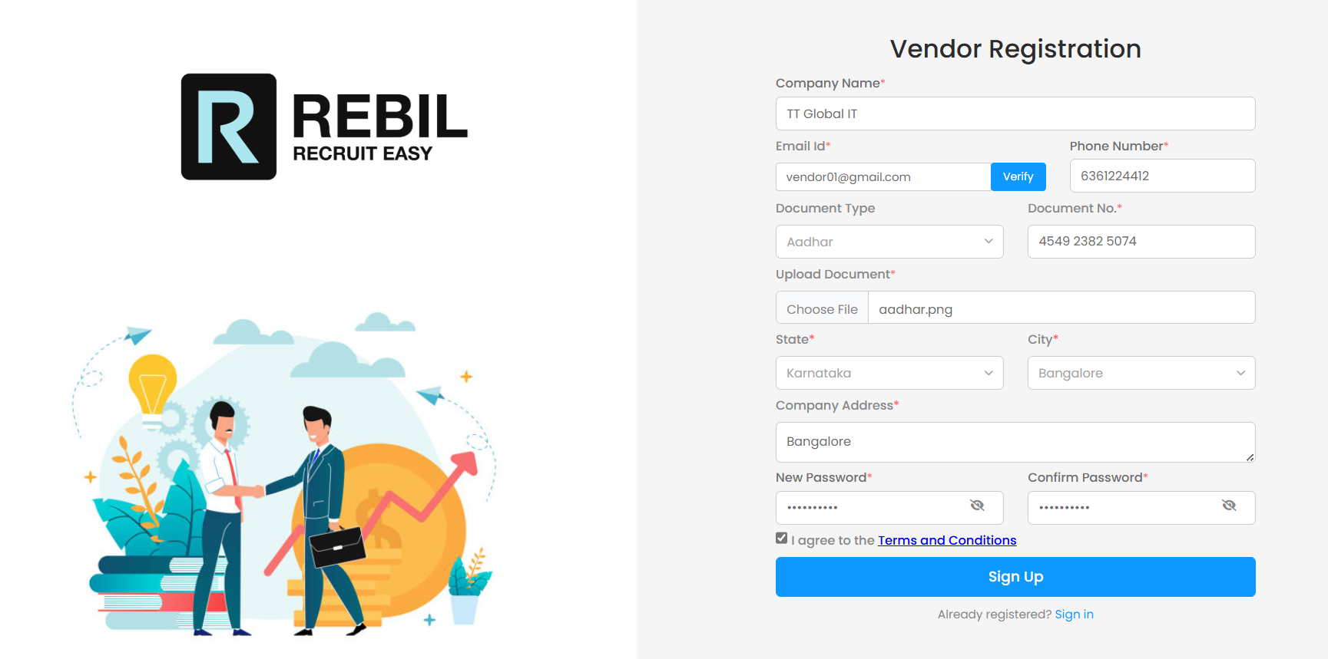
Vendor Registration Portal

Slide 14
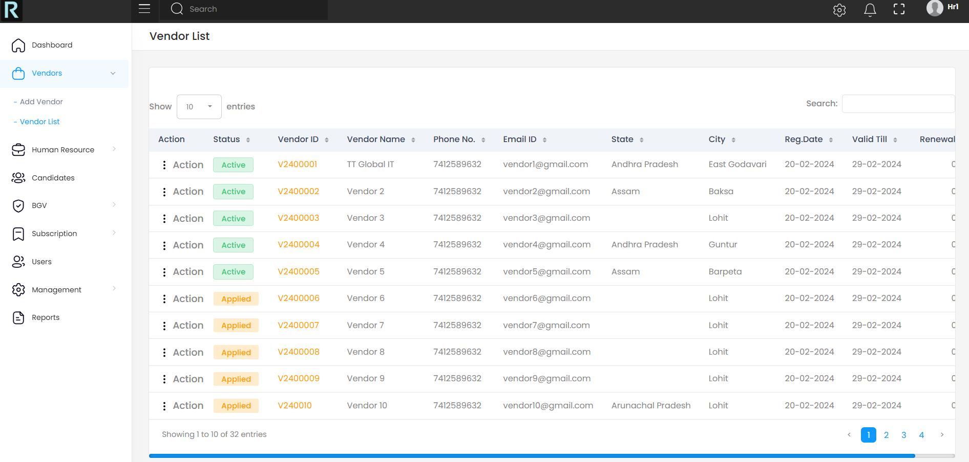
Vendor List

Slide 15
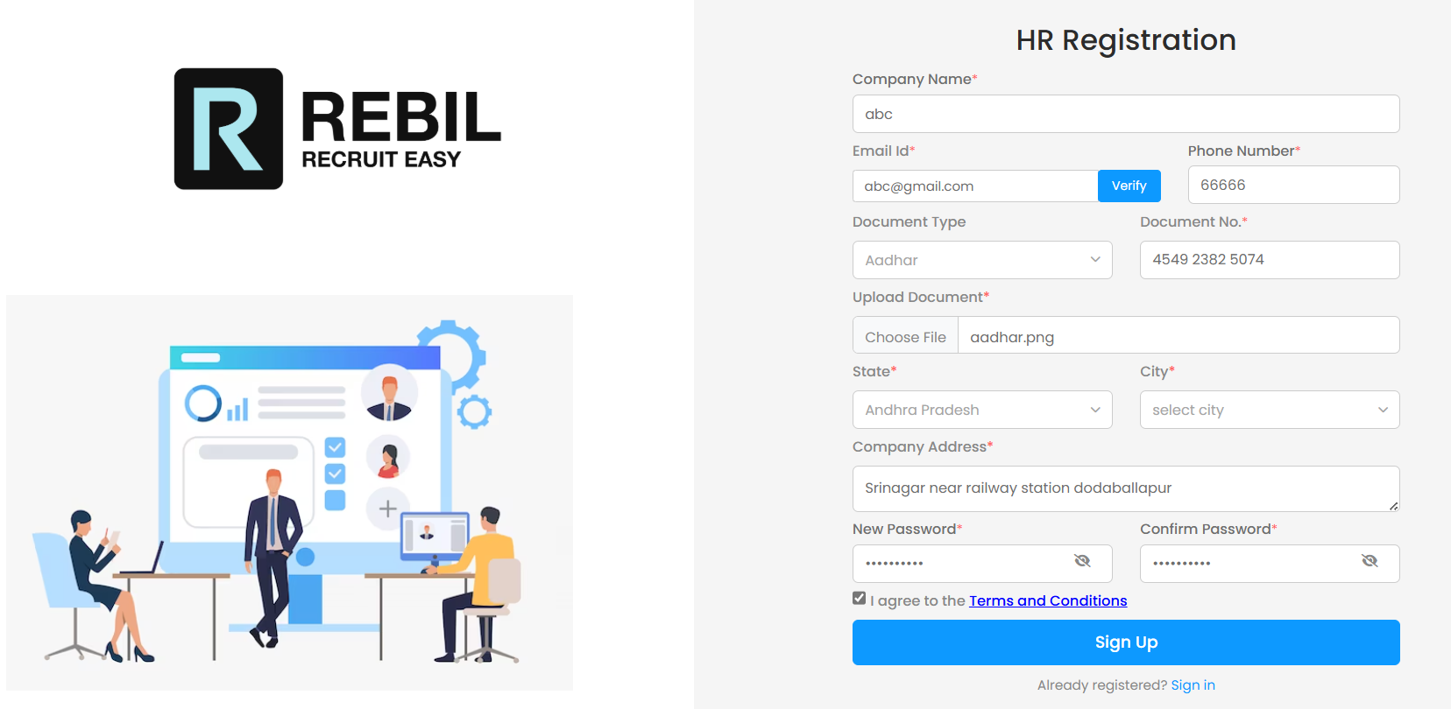
HR Registration Portal

Slide 16
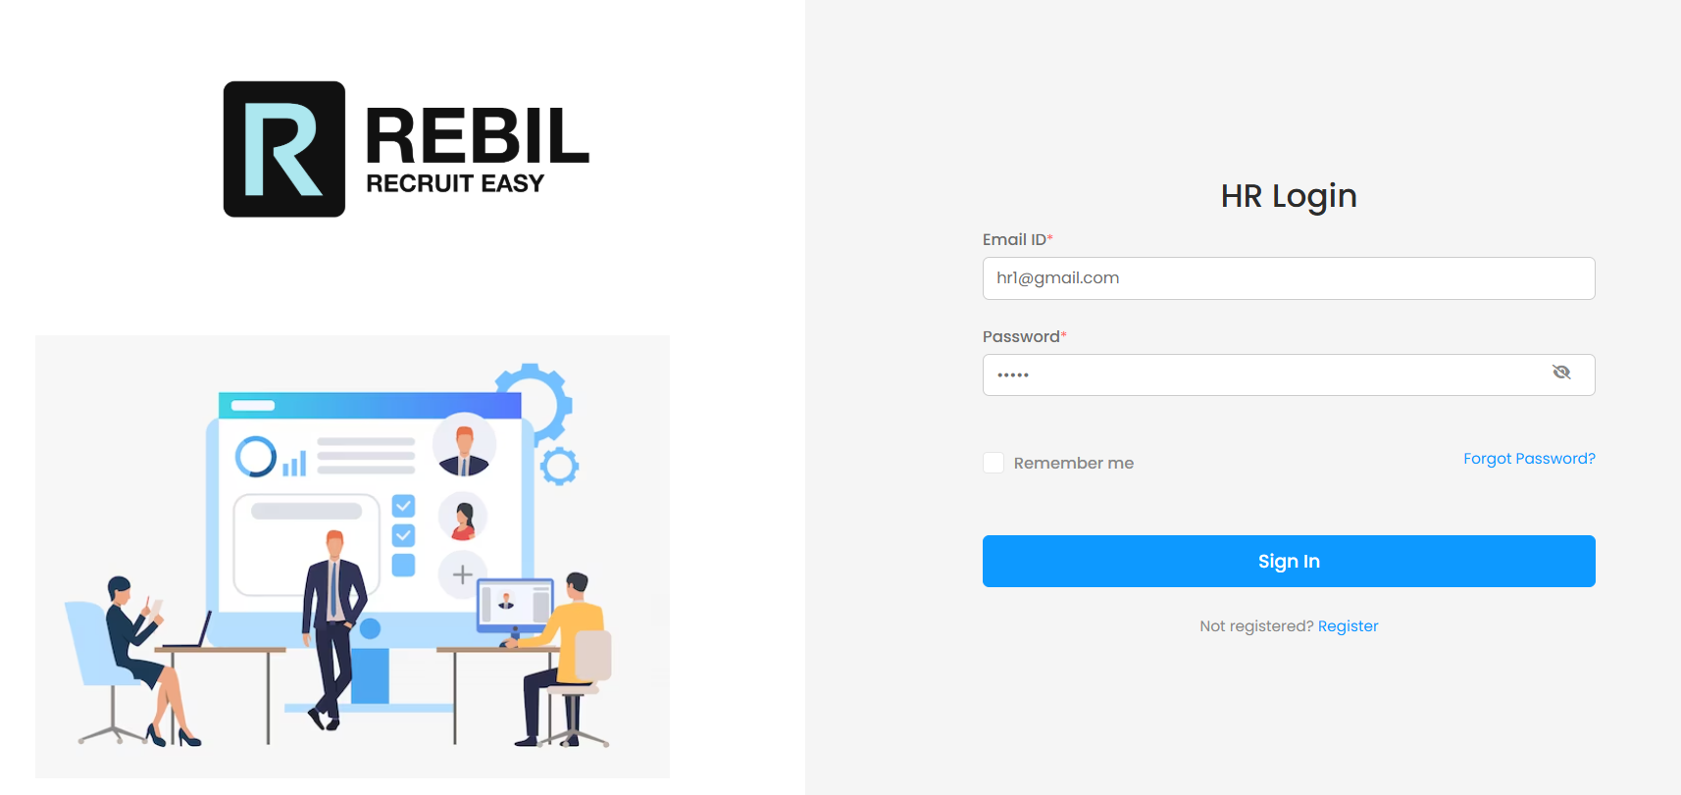
HR Login Portal

Slide 17
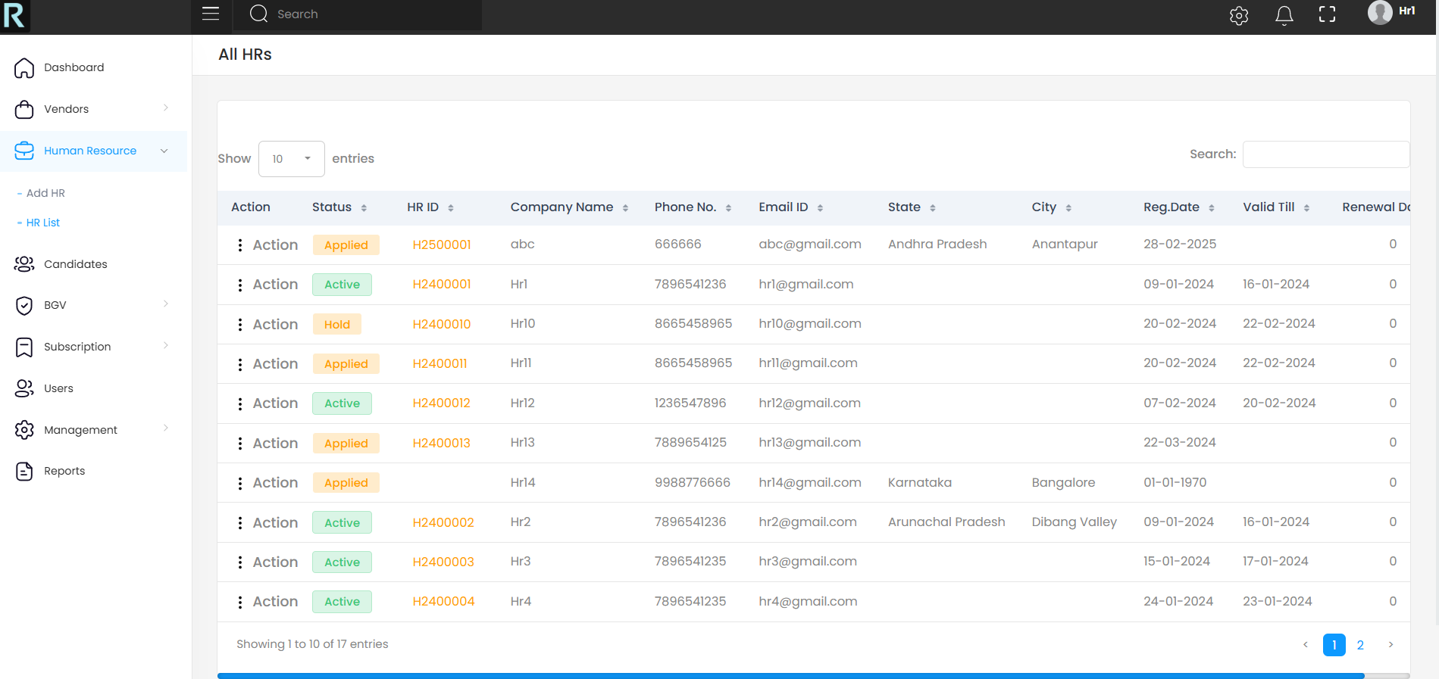
HR List

Slide 18
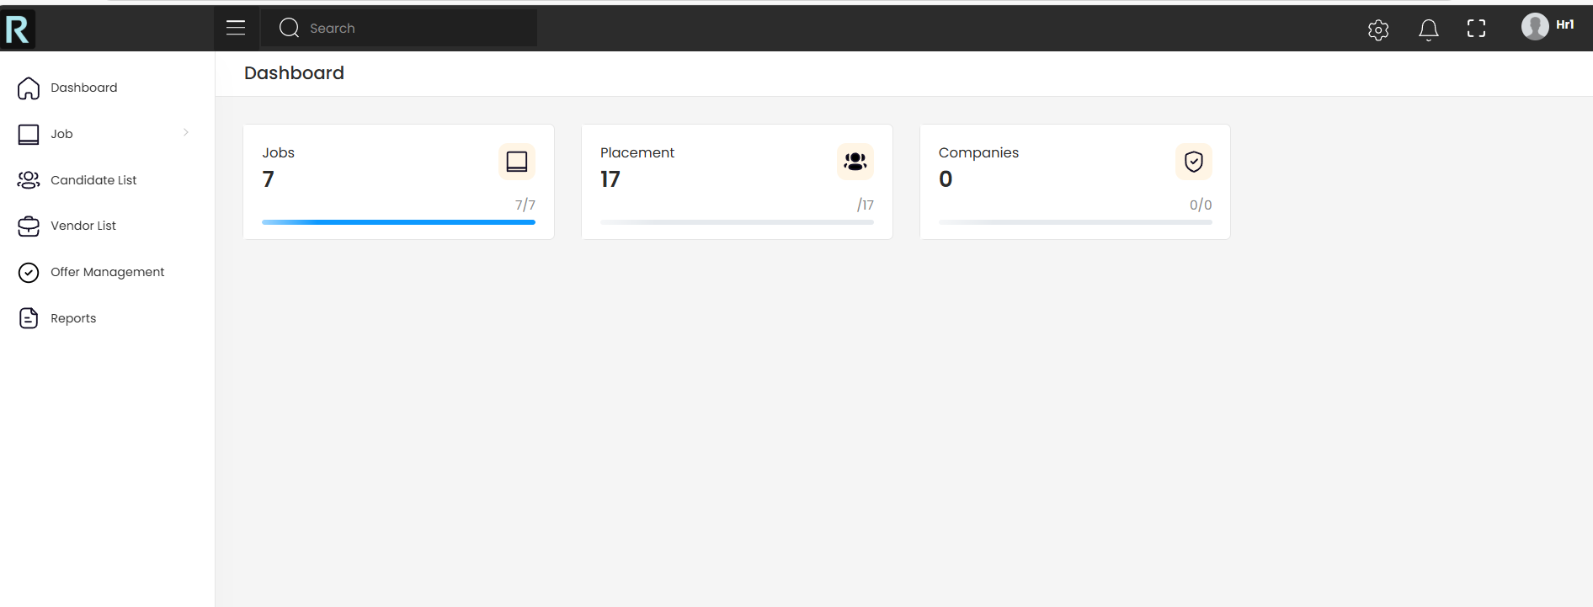
HR Dashboard

Slide 19
References
AI-Driven Recruitment and Selection: Enhanced HR Decision-Making with Accrued Benefits of Organizational Success - ResearchGate
Blockchain-based Authentication and Verification System for Academic Certificate using QR Code and Decentralized Applications - ResearchGate
Artificial Intelligence and Automation in Human Resource Development: Evidence from Emerging Economies - SAGE Journals
Leveraging AI for Effective Human Resource Management - SSRN
Artificial Intelligence in Human Resource: The Key to Successful Recruiting and Performance Management - ResearchGate
The Future of HR: The Role of AI-Powered Recruitment in Shaping Organizational Success - SCIRP
The Adoption of Artificial Intelligence in Human Resources Management and its Impact on Organizational Efficiency - ScienceDirect

Slide 20
Github Link
GitHub Repository:
https://github.com/Deepak-kumar-Singh-D/Rebil

Slide 21


